Slide 1

OPERATING SYSTEM
ADITYA COLLEGE OF ENGINEERING &
TECHNOLOGY
(Unit-2)
Communications in Client-Server Systems

Slide 2
Aditya College of Engineering &
Technology
Communications in Client-Server Systems
Sockets
Remote Procedure Calls
Remote Method Invocation (Java)

Slide 3
Aditya College of Engineering &
Technology
Sockets
A socket is defined as an endpoint for communication
Concatenation of IP address and port
The socket 161.25.19.8:1625 refers to port 1625 on host 161.25.19.8
Communication consists between a pair of sockets

Slide 4
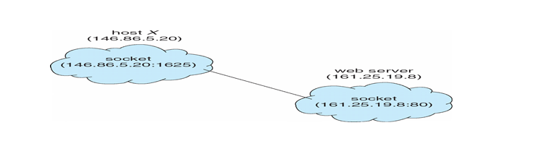
Aditya College of Engineering &
Technology
Socket Communication

Slide 5
Aditya College of Engineering &
Technology
Remote Procedure Calls
Remote procedure call (RPC) abstracts procedure calls between processes on networked systems
Stubs – client-side proxy for the actual procedure on the server
The client-side stub locates the server and marshalls the parameters
The server-side stub receives this message, unpacks the marshalled parameters, and peforms the procedure on the server

Slide 6
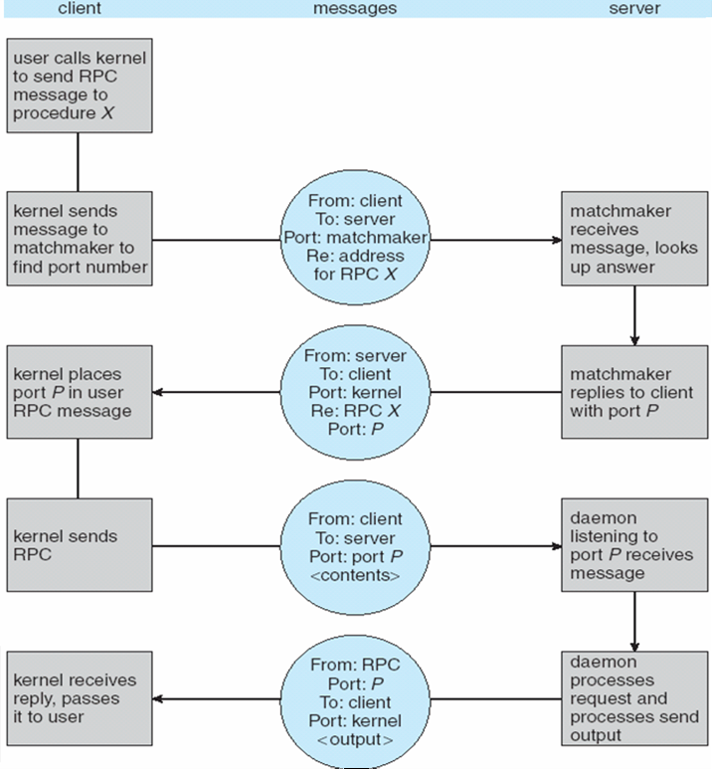
Aditya College of Engineering &
Technology

Slide 7
Aditya College of Engineering &
Technology
Remote Method Invocation
Remote Method Invocation (RMI) is a Java mechanism similar to RPCs
RMI allows a Java program on one machine to invoke a method on a remote object

Slide 8
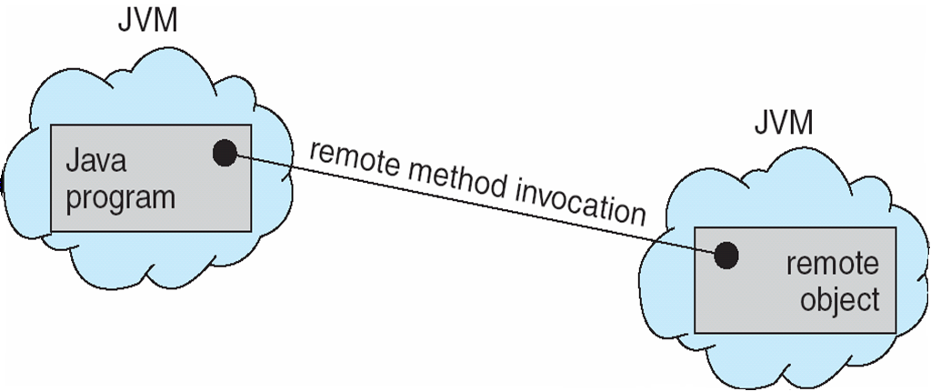
Aditya College of Engineering &
Technology

Slide 9
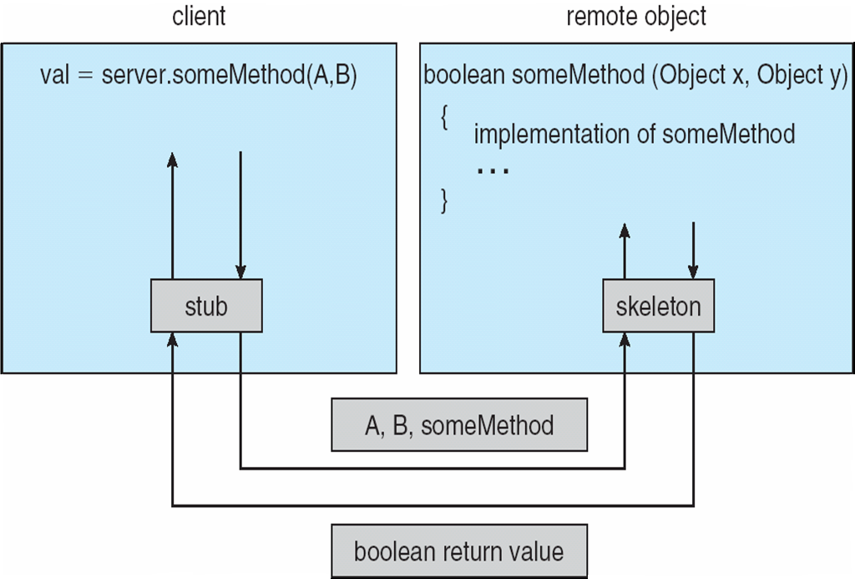
Aditya College of Engineering &
Technology
Marshalling Parameters

